Slide 1

WPC Extraordinary Meeting 7 Sep 2026
Murrell Green Proposal

Slide 2
AGENDA
The outline planning application – what is it?
Why is it not being considered as part of the Local Plan process?
  Changes to National Planning Policy
  Impact on Winchfield and the local area
WPC actions
Areas & topics being explored and assessed
Next steps

Slide 3
What is an Outline Planning Permission
Checks if a building project is acceptable in principle
What is Included
Use: What you want to do with the land
Amount: How big the project is or how many homes you want to build.
Access: Where people and vehicles will enter and leave the site.
Location and Site Plans: Maps showing where the property sits.
Reserved Matters (Saved for Later)
Appearance: What the outside of the building will look like.
Landscaping: Trees, plants, and gardens.
Layout: How buildings and roads sit on the land.
Scale: The height, width, length of the buildings and housing density.
Key Facts
Time: Councils usually take 13 weeks for major projects to be decided
Next Step: If approved, a reserved matters application must be submitted within a set time (usually 3 years) before you can build.

Slide 4
Lightwood Land Proposal
Outline application (with all matters reserved except access) for phased residential led mixed-use development comprising demolition of existing buildings/structures, provision of vehicular, cycle and pedestrian accesses (including details of 3no. accesses from the A30 London Road and 1no. access from the B3016 Odiham Road), development of up to 2,160 residential dwellings (including residential institution) (Use Class C2/C3), provision of employment, local centre and community uses (including education provision) (Use Classes E and F), blue and green infrastructure including sustainable drainage systems, public open space, sports pitches with pavilion, wildlife areas, Suitable Alternative Natural Green Space, and supporting infrastructure and associated works.

Slide 5
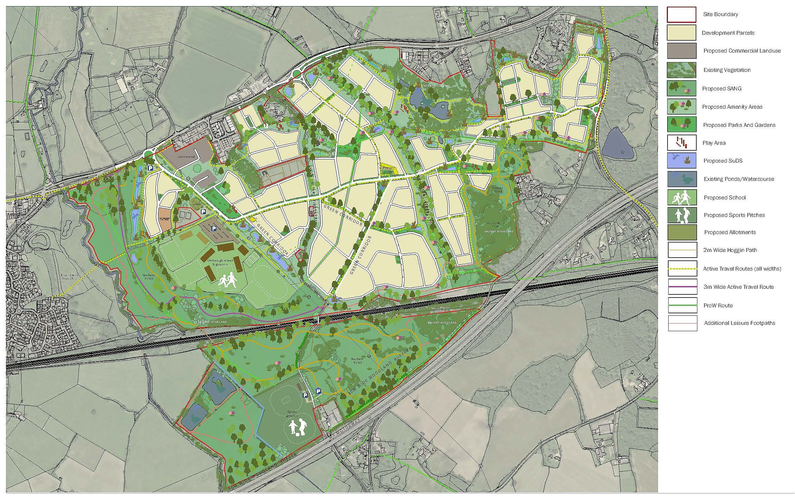

Slide 6
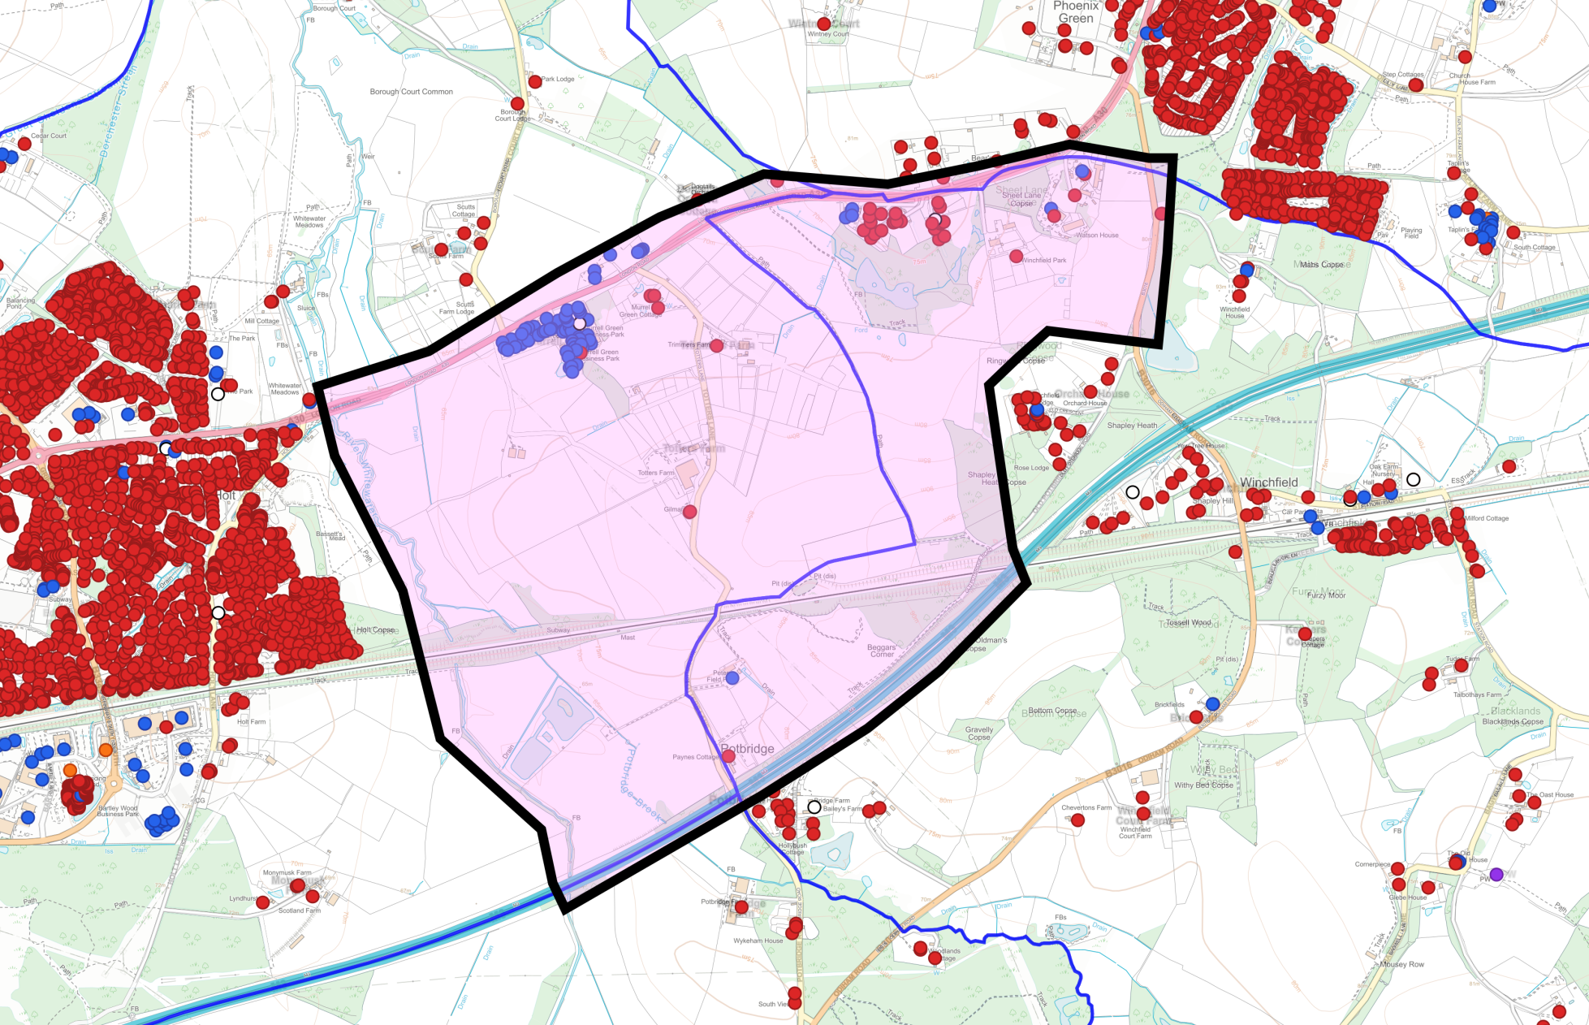
Coalescence – What do you think?

Slide 7
Why is it being considered outside of the
Local Plan Process?
Hart’s housing requirement has increased significantly (~14,400 homes between 2026 and 2044), affecting its ability to demonstrate a five-year housing land supply.
The applicant is therefore relying on “presumption in favour of sustainable development.”
Hart’s new Local Plan is still at an early stage, so it currently carries limited weight in planning decisions.
Hart must therefore consider the application now—but this does not mean it must be approved.
WPC’s position: A proposal of this scale, effectively creating a new settlement, should be assessed through the Local Plan process—alongside alternative sites and as part of a district-wide strategy for housing and infrastructure.

Slide 8
Key changes to the NPPF
The August 2026 NPPF is immediately relevant.
The key policy under which Murrell Green will be determined is Policy S5, regarding development outside of settlement boundaries due to HDC’s lack of a 5-year land supply.
Application of this policy at Murrell Green will test:
  A strategic development of this scale is genuinely physically well-related to an existing settlement; and
  2,160 homes can be accommodated, having regard to the existing and proposed availability of infrastructure.
Even if the proposal satisfies the requirements of Policy S5(1)(j), permission is not automatically to be granted by Policy S5. A planning balancing exercise must be undertaken to assess whether the benefits of allowing development outweigh the adverse effects.

Slide 9
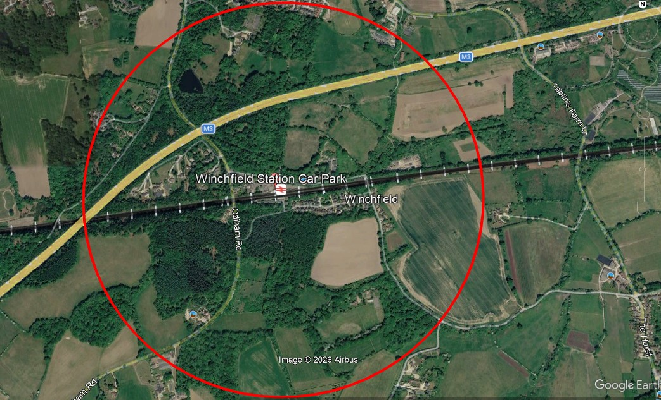
What it means for Winchfield
The new NPPF introduces a "default yes" presumption in favour of housing and mixed-use development near well-connected railway stations.
Well connected is defined by location (TTWA), service frequency & within around 800m walking distance.
Notes:
Location: Must sit within a Travel to Work Area (TTWA) ranked in the top 80 in England by Gross Value Added (GVA).
Service Frequency: Served by at least four trains/trams per hour overall during the daytime on weekdays, or at least two trains per hour in a single direction.
Walking Distance: Defined as around 800m from the qualifying station (only portions of a site within this 800m limit qualify). [1, 2]

Slide 10
HDC Planning Portal update
173 reports submitted by Lightwood Land
409 comment as of 2 Sep
Key consultee inputs
  National Highways
  Natural England
  Environment Agency
  Thames Water
  Wokingham Borough Council
  Bracknell Forest Council
  Rotherwick Parish Council
  Odiham Parish Council
  Hampshire & IoW Wildlife Trust
  East Hampshire District Council

Slide 11
WPC Actions to Date
Secured long term Planning Policy, Landscape and Heritage consultants early 2026
  Troy Planning
  Stone & Meadow
Commissioned specialist studies
  Ecology
  Highways and Transport
Working closely with Hook Parish Council and Hartley Wintney Parish Council

Slide 12
Key Areas being explored & Assessed
Planning & Transport
Planning context
How the proposal relates to national planning policy, Hart’s existing and emerging Local Plans and the Winchfield and Hook Neighbourhood Plans.
Scale and location
Whether development of this scale is appropriate in this location and how it would relate to Winchfield, Hook and the surrounding area.
Transport and movement
The potential effects on local roads, the wider highway network, Winchfield Station, public transport, walking and cycling.

Slide 13
Key Areas being explored & Assessed Infrastructure, landscape and heritage
Infrastructure
Whether schools, healthcare, water, wastewater and other essential services could support the development—and be delivered when they are needed.
Landscape and settlement identity
The potential effects on Winchfield’s rural landscape, important views and the separate identities of Winchfield, Hook and Hartley Wintney.
Heritage and local character
The potential effects on heritage assets, historic routes and the distinctive rural character of the area.

Slide 14
Key Areas being explored & Assessed
Ecology, water and Land Conditions
Ecology and green space
The potential effects on wildlife, trees and habitats, and whether the proposed green space would provide effective mitigation.
Flooding, drainage and water
The implications for flood risk, surface-water drainage, water supply and wastewater infrastructure.
Land conditions
Whether historic land uses and ground conditions have been investigated sufficiently and can be managed safely.

Slide 15
Key Areas being explored & Assessed Environmental and design considerations
Agricultural land and the environment
The permanent loss of a substantial area of Best and Most Versatile agricultural land and the wider environmental consequences.
Environmental information
Whether the information submitted provides a sufficiently complete understanding of the development’s likely effects.
Design and development principles
Whether the outline proposals provide adequate control over matters such as scale, density, movement, landscape buffers and green infrastructure.

Slide 16
Key Areas being explored & Assessed
Delivery and overall assessment
Housing and community benefits
The proposed contribution to housing, including affordable housing, the timing of delivery and the extent to which the promised benefits would meet local needs.
Delivery and accountability
Whether the infrastructure, facilities and mitigation being proposed can be secured and delivered at the right stages of the development.
Overall assessment
Whether the claimed benefits of the development would outweigh its effects on Winchfield and the surrounding area.

Slide 17
Next steps for WPC
Encourage comprehensive submissions by Rushmoor and Basingstoke & Deane Councils
Engage with Highways Agencies and Natural England
Our representations are being informed by planning policy, ecology, landscape, heritage and transport advice. Our assessment will continue to develop as specialist reviews and consultee responses are received.
Review draft Reps with HPC and HWPC and OPC will also submit supportive additional response
Independent review by an experienced Planning Inspector
Submit to HDC Monday 5th October

Slide 18
Reminder of the Key Issues
Traffic and Movement (Active Travel)
Water, Drainage and Flooding
Landscape, Heritage and Coalescence
Ecology and Biodiversity
Schools and Healthcare
Delivery and Accountability

Slide 19

Next steps for you
Have your say – submit a response to HDC by 18 Sep
View murrellgreen.info website
https://murrellgreen.info/
      Include your name and address and reference 26/01201/OUT
    Handouts available as you leave
Any questions?

